Slide 2
THE DISCIPLES RELATIONSHIP:
TO HIMSELF
An Athlete
A Soldier
TO HIS LORD
The Potter and the Clay
The Vine and the Branches
A Child of God
TO HIS BRETHREN
A Member of the Body
“My Brother’s Keeper”
A Servant
TO THE WORLD
Strangers & Pilgrims
Salt & Light
An Apologist
Fishers of Men

Slide 3
LESSON 3: A Soldier The Disciple’s Battle
Suffer hardship with me, as a good soldier of Christ Jesus. (2 Timothy 2:3)

Slide 4
The Disciple as a Soldier
We have a Commander
We have an Enemy
The Battleground
We have Armor
We must Train
We must Fight
“…be strong in the grace that is in Christ Jesus…Suffer hardship with me, as a good soldier of Christ Jesus. No soldier in active service entangles himself in the affairs of everyday life, so that he may please the one who enlisted him as a soldier.” (2Tim. 2:1,3-4)

Slide 5
The Disciple as a Soldier
We have a Commander
We have an Enemy
The Battleground
We have Armor
We must Train
We must Fight
“Be of sober spirit, be on the alert. Your adversary, the devil, prowls around like a roaring lion, seeking someone to devour.” (1Pet. 5:8)

Slide 6
The Disciple as a Soldier
We have a Commander
We have an Enemy
The Battleground
We have Armor
We must Train
We must Fight
“For though we walk in the flesh, we do not war according to the flesh, for the weapons of our warfare are not of the flesh, but divinely powerful for the destruction of fortresses. We are destroying speculations and every lofty thing raised up against the knowledge of God, and we are taking every thought captive to the obedience of Christ…” (2Cor. 10:3-5)

Slide 7
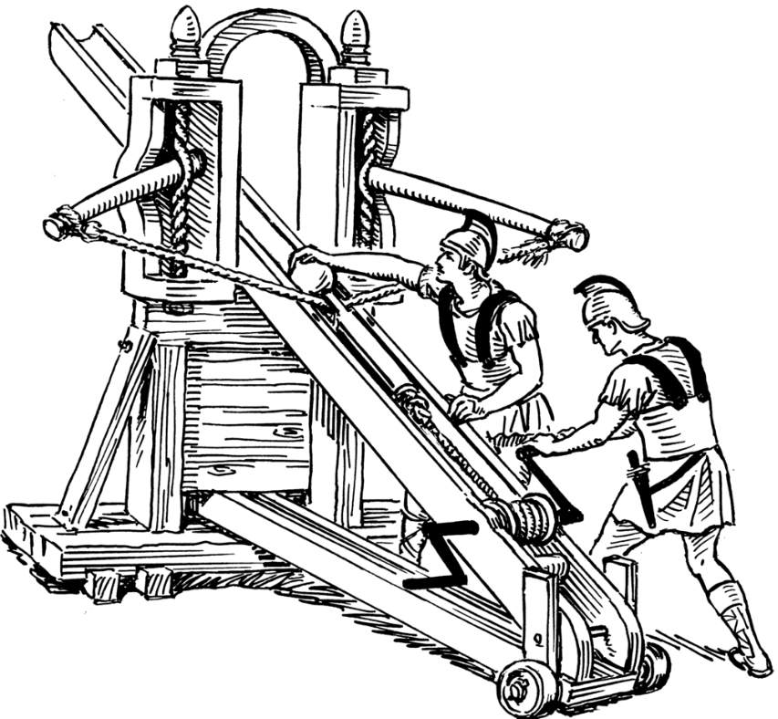
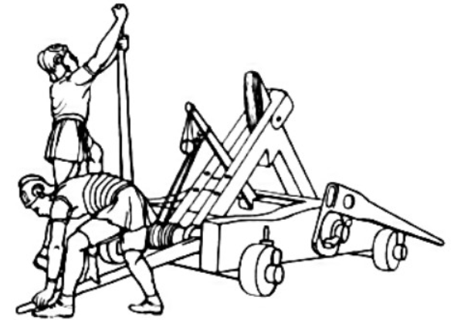
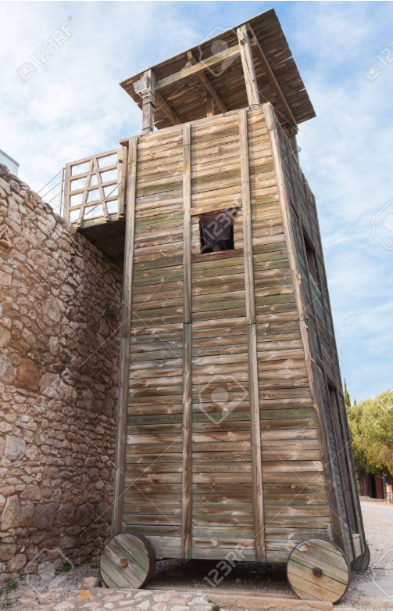
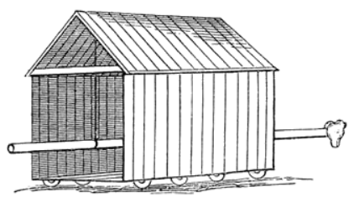
The Disciple as a Soldier
Onager
Siege
Tower
Ballista
Battering Ram

Slide 8
The Disciple as a Soldier
We have a Commander
We have an Enemy
The Battleground
We have Armor
We must Train
We must Fight
“For though we walk in the flesh, we do not war according to the flesh, for the weapons of our warfare are not of the flesh, but divinely powerful for the destruction of fortresses. We are destroying speculations and every lofty thing raised up against the knowledge of God, and we are taking every thought captive to the obedience of Christ…” (2Cor. 10:3-5)

Slide 9
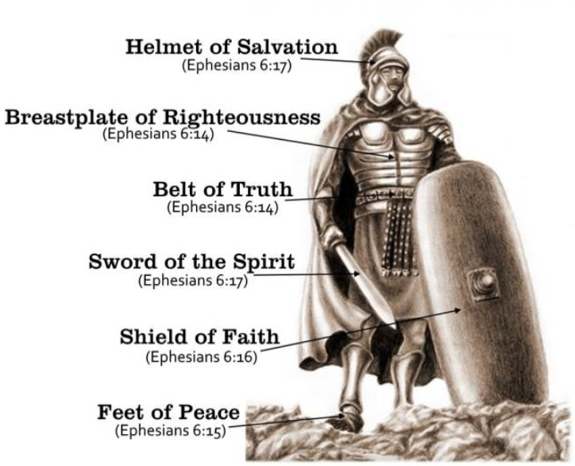
The Disciple as a Soldier
We have a Commander
We have an Enemy
The Battleground
We have Armor
We must Train
We must Fight
Eph. 6:10-17

Slide 10
The Disciple as a Soldier
We have a Commander
We have an Enemy
The Battleground
We have Armor
We must Train
We must Fight
“For everyone who partakes only of milk is not accustomed to the word of righteousness, for he is an infant. But solid food is for the mature, who because of practice have their senses trained to discern good and evil.” (Heb. 5:13-14)
“Therefore be careful how you walk, not as unwise men but as wise, making the most of your time, because the days are evil.” (Eph. 5:15-16)

Slide 11
The Disciple as a Soldier
We have a Commander
We have an Enemy
The Battleground
We have Armor
We must Train
We must Fight
Fight (1Tim. 6:12)
Wrestle (Eph. 6:12)
Resist (1Pet. 5:9; Jam. 4:7)
Endure Hardship (2Tim. 2:3)

Slide 12
Discipleship this week
What worldly activities are hindering your growth and preparedness as a soldier of Christ?
What battles are you currently fighting? Where do you go for help?
What are your current strengths in your armor? What are your current weaknesses? What are you doing to transform your weaknesses to become your strengths?

